Slide 1
SCC211 Operation System
(Process Management)
Zhang Jinyu – zjy@bjtu.edu.cn
School of Computer and Information Technology
SD408

Slide 2
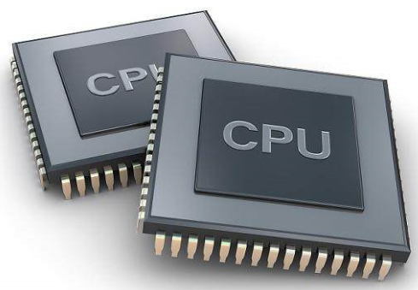
Objectives
Life-cycle of individual processes (threads) managed in Java and Unix/C
Clarify distinctions between:
Unix-like processes
User threads
Kernel threads
Language-level threads
灵活
高效

Slide 3
Java Thread Method
start() | Begin a thread
stop() | Irrevocably stops a thread (deprecated!)
currentThread() | Currently executing thread
suspend(), resume() | Temporarily pause/resume the thread
toString() | Return thread name, priority, and thread group
getId() | Return thread id
sleep() | Suspend calling thread for specified time (ms）
isAlive() | Return true if targer thread is started and not yet stopped
join() | Suspend calling thread until target thread completes
getname(), setname() | Get and assign thread name

Slide 4
Alternative to Java Thread Creation
Threaded class implements Runnable (as before), but you hide thread creation inside the new class
The constructor of your new class, say ThreadedClass contains new Thread(this).start();
To create the thread you simply call: new ThreadedClass();

Slide 5
Implement
class ThreadedClass implements Runnable {
ThreadedClass() //Constructor
{ new Thread(this).start(); }
}
…
new ThreadedClass();
…

Slide 6
Some System Calls for Unix Processes
MIT 设计
start() | Begin a thread
fork() | Create a ‘child’ process
wait() | Block until child process dies
execve() | Make a calling process run a new program
kill() | Send a ‘signal’ to a process (graceful exit)
signal() | Set a function to be called on arrival of ‘signal’
pause() | Make calling process block until a ‘signal’ arrives
exit() | Shutdown (non graceful)
getpid() | Get a process identifier of calling process

Slide 7

fork()
Fork() creates an almost identical copy (child) of the calling process (parent)
Child has the same program as the parent
Child has copies of the same variables with identical values as the parent
Child resumes execution at the instruction following fork() system call (but on new stack)
Only difference visible to program is the value returned from the fork() call
In the child this is 0; in the parent it is > 0 ( setjmp() and longjmp() )
The actual value returned happens to be process identifier of the child
Fork()创建调用进程(父进程)几乎完全相同的副本(子进程)
子进程具有与父进程相同的程序
子节点拥有与父节点相同值的相同变量的副本
子线程在fork()系统调用之后在指令上恢复执行(但在新堆栈上)
唯一对程序可见的区别是从fork()调用返回的值
在孩子身上，这是O;在父类中是> 0
实际返回值恰好是子进程的进程标识符

Slide 8
Unix Example
/* file: main.c */
int main() {
int pid, status;
if ((pid == fork()) < 0)
{ /* Handle error */ }
else if (pid == 0)
{ execve (“prog”,””, 0);
/*NOT REACHED*/ }
else { kill (pid, SIGINT);
pid = wait(&status); } }
/* file: prog.c */
int main() {
signal(SIGINT, trap);
pause();
exit(0); }
int trap() {
printf(“%d: Got it!\n”, getpid()); }
失败
陷阱:设计好的，告警
创建成功
发生问题，出来
杀死parent

Slide 9
Question
int main() {
int i;
for(i=0; i<4; i++) fork();
}
考试题
How many processes are created when executing this program?
(Give a reasoned argument and/or draw a diagram to support your answer)
How many processes are created by the program as a function on n?

Slide 10
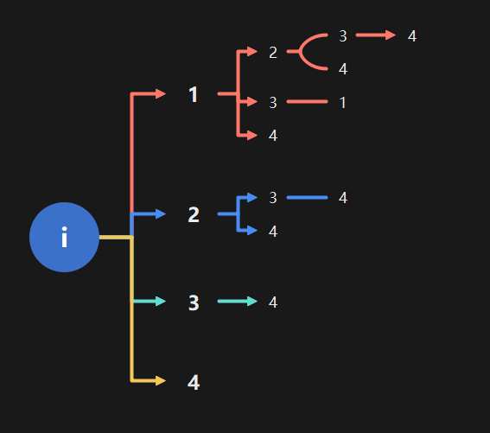
Answer
1->2->4->8->16
15 processes are created
(16 if including original)
2^{n} - 1
Top level creates 4:
1st creates 3:
1st creates 2:
1st creates 1:
this creates 0
2nd creates 0
2nd creates 1:
this creates 0
3rd creates 0
2nd creates 2:
1st creates 1:
this creates 0
2nd creates 0
3rd creates 1:
this creates 0
4th creates 0
执行fork时，子进程拷贝当前变量值和之后将要执行的代码（已经执行的不会再执行）

Slide 11
Unix Process Hierarchy
Every Unix process (except one!) has a parent
Processes may create multiple children (via fork())
Example: The (traditional) Unix boot procedure
Single parentless process runs (init)
init reads a file which lists all connected terminals
init forks a login process for each terminal
If a login process validates a user, it forks a shell process…
启动程序
命令行

Slide 12
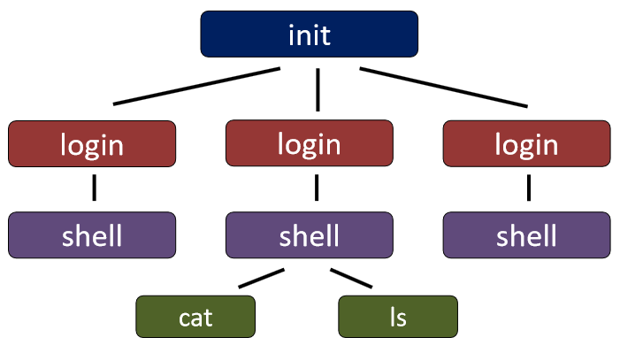
子进程
fork

Slide 13
The Unix Shell (Command Line)
/* shell program */
While(TRUE) {
read_command(&command, &params);
if (fork() == 0) {
execve(command, params, 0); //Child }
else { wait(&status); } }
所用的造作系统都是死循环
处于阻塞

Slide 14
Unix-style Processes
Threads share a common address space
Can easily cooperate on common tasks
Lighter-weight switch; support fine-grained concurrency
线程切换：轻
进程切换：重
线程共享一个公共地址空间

Slide 15
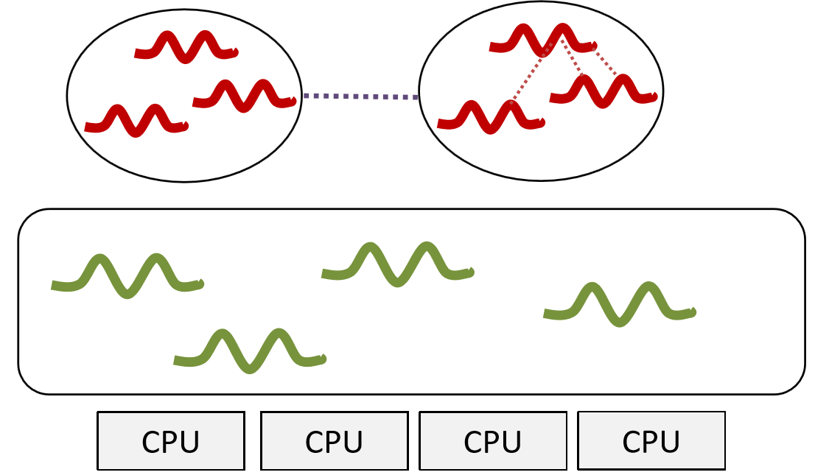
Process
Process
Thread
Thread
Process
Thread

Slide 16
Threads: User vs Kernel vs. Language
User Threads ̶ Supported in user-level library
Kernel only knows about processes
Scheduled by a per-process, user-level scheduler
Kernel threads ̶ Supported by OS
Scheduled by OS scheduler
Threads are preempitable by the OS
Potentially more concurrent, especially on multicore
More predictability useful for real-time applications
OS itself is multithreaded ̶ Supported in almost all modern OS
Threads in language runtime environments (Java)
Available only in particular language environments
Might be implemented either as user or kernel threads
按用户调度
适合实时
OS调度
抢占
与接近OS，速率越高
有计划性

Slide 17
User vs. Kernel Threads
考试题
0和通常比内核线程切换快一个数量级-(内核线程切换本身比进程切换快一个数量级…)提供每个应用程序调度策略作为
User thread Advantages
No OS support required ̶ Cheap context switch
Typically order of magnitude faster than kernel thread switch ̶ (Which itself is an order of magnitude faster than process switch…)
Easy to offer per-application scheduling policies
User thread disadvantages
If thread calls a system call that blocks, all other threads in that process also block (all reduce to the one underlying process)
User threads in same process can’t execute on separate CPUs on multicore – as the OS is not user-thread aware
阻塞
OS看不到线程
User threads most useful for structuring conceptually concurrent applications (GUIs, RPC servers, some web servers)

Slide 18
Inside the JVM at a glance
Java Stack (created per thread)
Contains local variables, parameters and return values
核心内存1M,在芯片上
Heap (one per JVM)
Contains shared objects only, arrays (which are objects!)
Method
Class (or static) variables – these are shared by all threads

Slide 19
Summary
runnabe,直接创建，接口
Various patterns for creating threads in Java
Java’s Thread class has various methods for process management
Unix processes are created through the fork() call
There are other calls for process management
Threads are distinct from the Unix notion of a ‘process’
User threads require no support from the OS
Kernel threads are supported by the OS
Language threads can be either user level or kernel level
虚拟机

Slide 20
Question？

